Slide 1


Vertex AI Model Registry: Versioning Alias Strategy
Managing Custom Container Lifecycles for Production Pipelines
TECHNICAL ENABLEuE
T SERIES _{I} MLOPS STANDARD OPERATING PROCEDURES

Slide 2
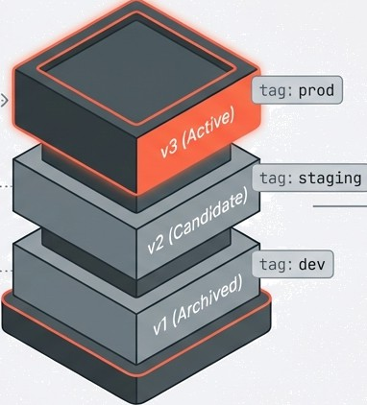
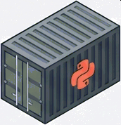
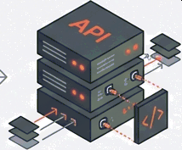
The Artifact Journey:
From Container to Prediction
Training
(Custom Container)
Serving
(Prediction Endpoint)
Vertex AI Model Registry
The Registry acts as the decoupling point.
It transforms raw container artifacts into managed, versioned, and deployable assets.

Slide 3

Step : Encapsulating Logic with Custom
Containers
Why Custom Containers?
Essential for models requiring specific library versions, system-level dependencies, or custom prediction
routines not supported by pre-built binaries.
Immutable Ima ge URI
The Workflow
You build the image once; Vertex AI Model Registry references this immutable image URI for every subsequent training run or model upload.
Docker file
Build Process
Custom Image
Artifact Registry
G NotebookLM

Slide 4
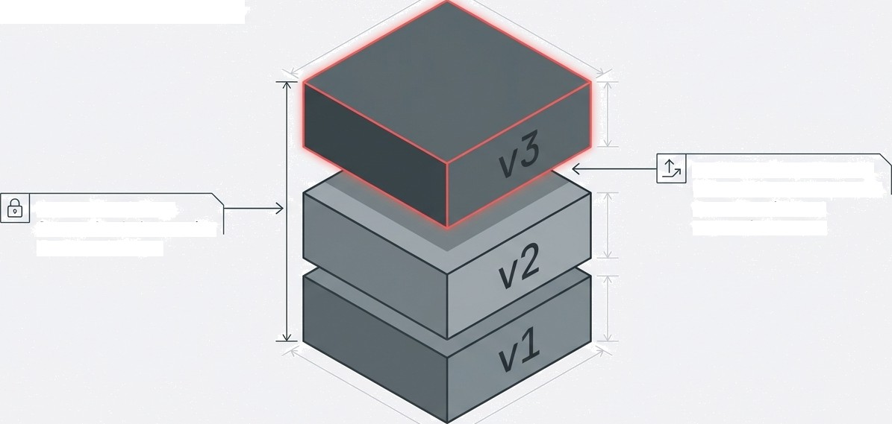
Step 2: Stability through Auto-Versioning
Automatic Incrementing: Uploading to an existing ID generates the next sequential number.
Immutable History: Once uploaded, a version ID never changes.

Slide 5



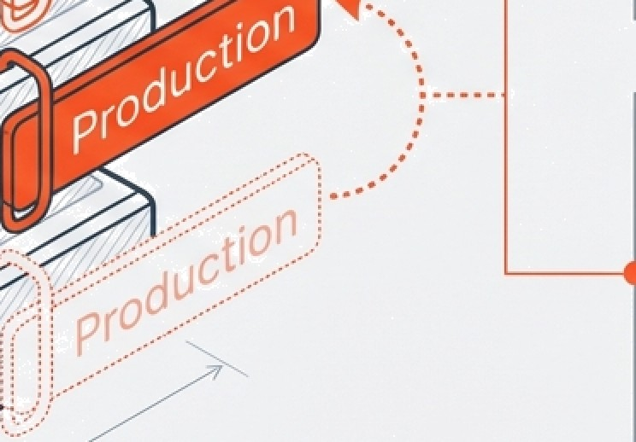
Step
Agility through Model Aliasing
**Mutable Pointers**:
Aliases are user-defined references (e.g., ‘prod’, ‘challenger’) that point to specific version IDs.
*Z
*2
”*Decoupled Deployment”*:
Application code references the Alias, not the Version. This allows backend model swaps without frontend code changes.
*1
G NotebookLM

Slide 6




Implementation: Registration with Aliases
Python
*’Auto-Versioning Trigger*’
Linking to an existing model ID causes this upload to become v+1.
from googIe.cloud import aiplatfonm
riodet a1ptatforri. Model. upload(
display name=”my ouszom_mode{”,
artifact uri-”gs://my-bucket/saved model”,
serving container image uri-”gcr.io/prj/my-image”,
parent nodes="projects/123/...
version aI1ases= I" staging ',
/modeIs/my-model- id"
"exper'iment_a" ]
**Immediate Tagging*’:
Assigns mutable tags at the moment of creation, saving manual API calls.
G NotebookLM

Slide 7
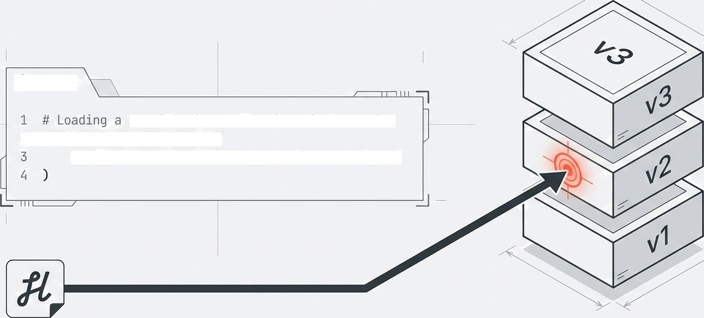
Consumption Strategy A: Loading by Version
Use Case: Debugging, Auditing, Scientific Reproducibility
Python
specific immutable historical version
2 model = aiplatfonm.Nodel(
model_name=”pnojectS/.../mode{s/my-model-id@2”

Slide 8

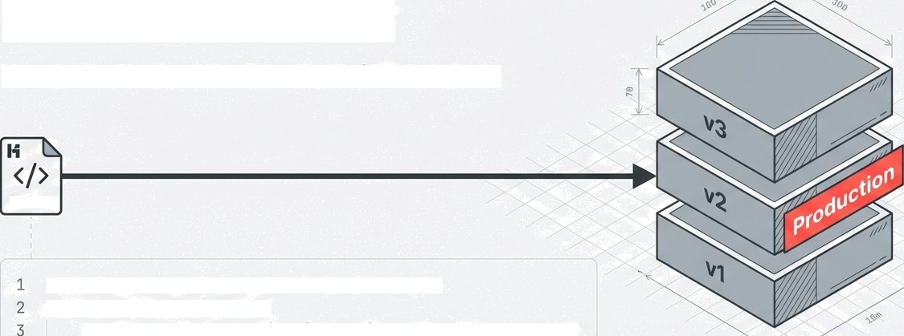

Consumption Strategy
Loading by Alias
Use Case: Production Serving, CI/CD Pipelines
Python
# Loading the dynamic pointer for production
model = aipTatforrt.I1ode1I
r›odeT_nar›e="projects/ ... /nodeTs/riy-riodet-1dgproduct1on"
If the alias moves to v3, the code does not need to change.

Slide 9


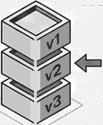
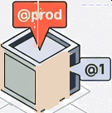
Summary: The Managed Lifecycle Standard
Training Phase | Registration Phase |  | Prediction Phase
Action: Use Custom Containers. Why: Maximum flexibility for dependencies and system requirements. | Action: Define pa nent_mode1 & Assign Aliases. Why: Maintains clean history (Versioning) while establishing intent (Aliasing). |  | Action: Load by Alias (§prod ) for Apps; Version (p1 ) for Debugging. Why: Ensures production stability while retaining scientific reproducibility. › e
G NotebookLM

